Slide 1


Introduction to Machine Learning, Deep Learning
Subikash Pal
GitHub: https://github.com/Subikash/
Linkedin: www.linkedin.com/in/subikash-pal-4b5b1524
Kaggle :https://www.kaggle.com/subikashpal
© 2017, Amazon Web Services, Inc. or its Affiliates. All rights reserved.

Slide 2
Agenda
Introduction
Machine Learning
Deep Learning
Conclusion

Slide 3
Introduction
Artificial Intelligence
Machine Learning Deep Learning

Slide 4
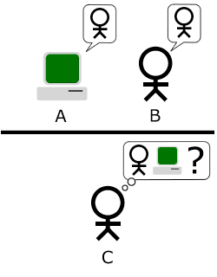
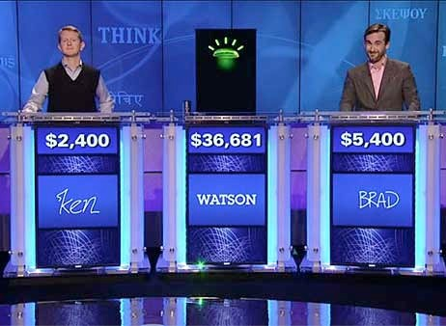
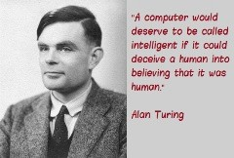
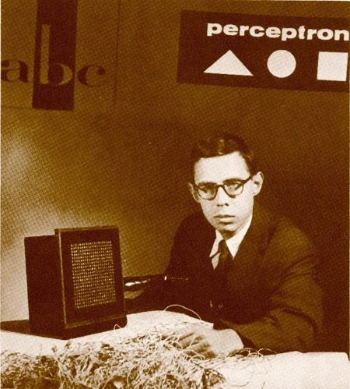
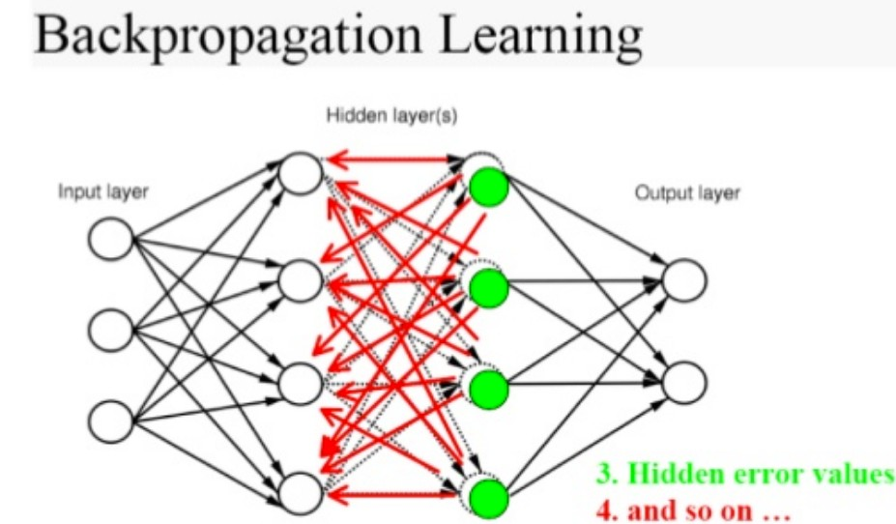
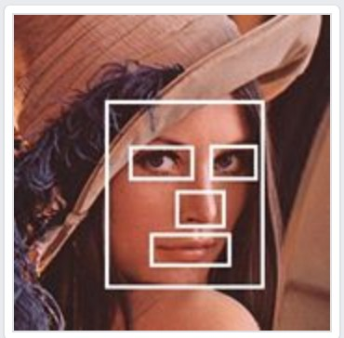
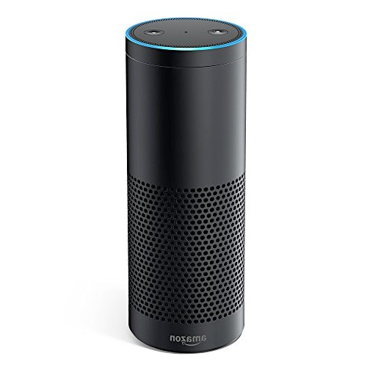
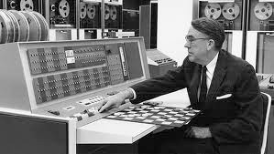
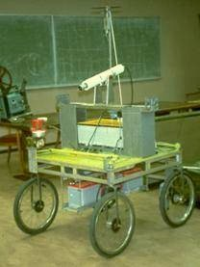
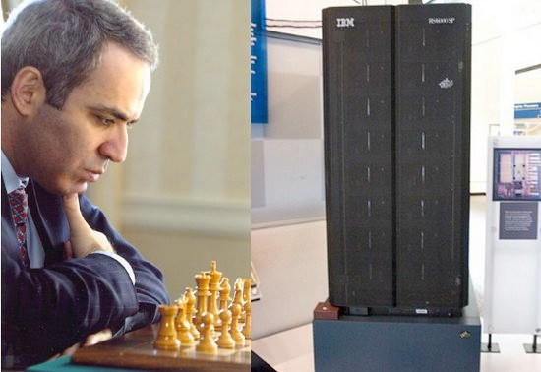
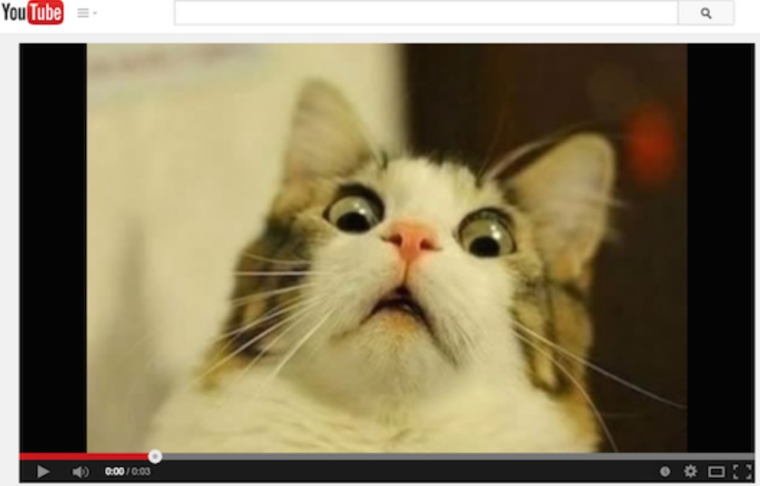
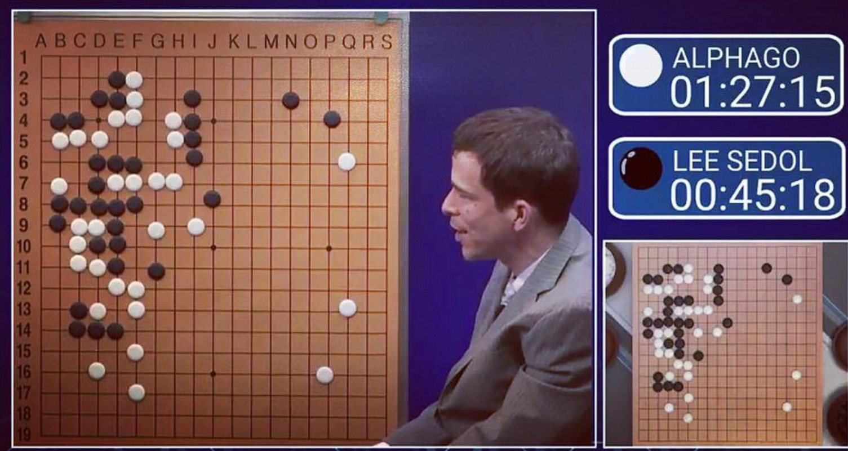
Timeline Of Intelligent Machines
The Learning Machine (Alan Turing)
Perceptron
(Frank Rosenblatt)
Backpropagation
(D. Rumelhart, G. Hinton, R. Williams)
Watson Wins Jeopardy
Facebook DeepFace, Amazon Echo
Machine Playing Checker
(Author Samuel)
Stanford Cart
Deep Blue Beats Kasparov
Google NN recognizing cat in Youtube
DeepMind Wins Go
1950
1952
1957
1979
1986
1997
2011
2012
2014
2016

Slide 5
What is Machine Learning?

Slide 6
Option 1- Build A Rule Engine
Human Programmer
Input
Rule 1: 15 <age< 30
Rule 2: Bought Toy=Y, Last
Purchase<30 days Rule 3: Gender = ‘M’, Bought
Toy =‘Y’
Rule 4: ……..
Rule 5: ……..
Output
Age | Gender | Purchase Date | Items
30 | M | 3/1/2017 | Toy
40 | M | 1/3/2017 | Books
…. | …… | ….. | …..
Age | Gender | Purchase Date | Items
30 | M | 3/1/2017 | Toy
…. | …… | ….. | …..

Slide 7
Scalability
Adaptability Closed Loop
Problem with Hand Designed Rules

Slide 8
Option 2 - Learn The Business Rules From Data
Input - New Unseen Data
Age | Gender | Items
35 | F
39 | M | Toy
Age | Gender | Purchase Date | Items
30 | M | 3/20/2017 | Toy *
40 | M | 1/3/2017 | Books
…. | …… | ….. | …..
Learning Algorithm
Model
Prediction
Output
Historical Purchase Data (Training Data)

Slide 9
Train the Model
Training Data
Test Data
(Un)Supervised Algorithm
Model
Model
Output
We Call This Approach Machine Learning

Slide 10
Why Use Machine Learning?
Use ML when you can’t code it
Complex tasks where deterministic solution don’t suffice
E.g. Recognizing speech/images
Use ML when you can’t scale it
Replace repetitive tasks needing human like expertise
E.g Recommendations, spam, fraud detection, machine translation.
Use ML when you have to adapt/personalize
E.g. Recommendation and personalization
Use ML when you can’t track it
E.g. Automated driving, fraud detection.

Slide 11
Types Of Machine Learning

Slide 12
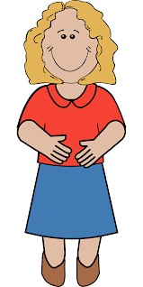
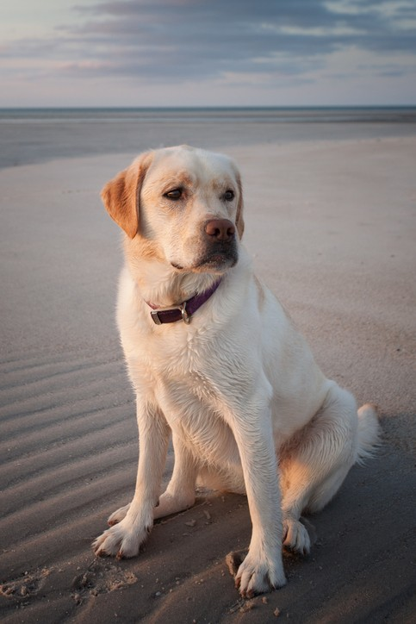
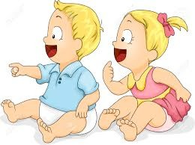
Supervised Learning
No, it’s a Labrador.
It is a cat.

Slide 13

Supervised Learning – How Machine Learn
Human intervention and validation required
e.g. Photo classification and tagging
Training Data
Adjust Model
Input
?
Machine Learning Algorithm
Prediction
Label
Labrador
Cat
Labrador
Label

Slide 14
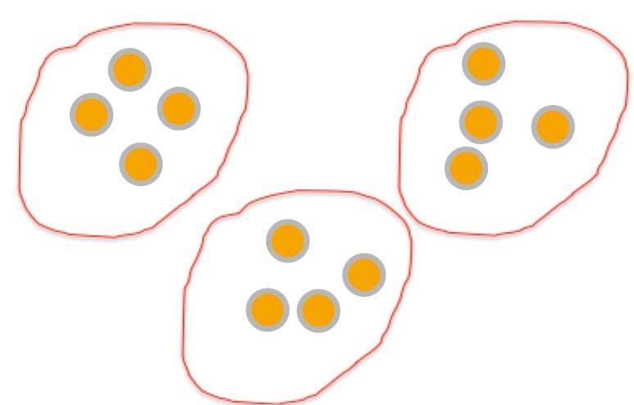
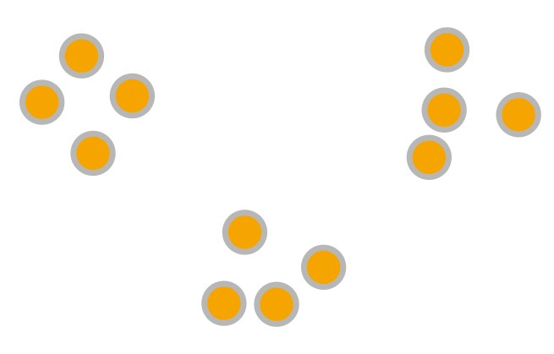
Unsupervised Learning
No human intervention required (e.g. Customer segmentation)
Machine Learning Algorithm
Prediction
Input

Slide 15
Model Training

Slide 16



Model Training – Split training data
All Labeled Dataset
70%
30%
Training Data

Slide 17
Model Training – Training w/ training data
All Labeled Dataset
70%
30%
Training
Trial Model
Training Data

Slide 18

Model Training – Split the test data
All Labeled Dataset
Test Data
70%
30%
Training
Trial Model
Training Data

Slide 19
Model Training – Model evaluation
All Labeled Dataset
Test Data
70%
30%
Training
Trial Model
Training Data
Evaluation Result

Slide 20


Model Training - Performance Measurement
All Labeled Dataset
Test Data
70%
30%
Training
Trial Model
Training Data
Accuracy
Evaluation Result

Slide 21

Deep Learning
© 2017, Amazon Web Services, Inc. or its Affiliates. All rights reserved.

Slide 22
What is Deep Learning?
Deep Learning is a subfield of machine learning concerned with algorithms inspired by the structure and function of the brain called artificial neural networks.
Data is passed through multiple non-linear transformations to generate a prediction
Objective: Learn the parameters of the transformations that minimize a cost function

Slide 23
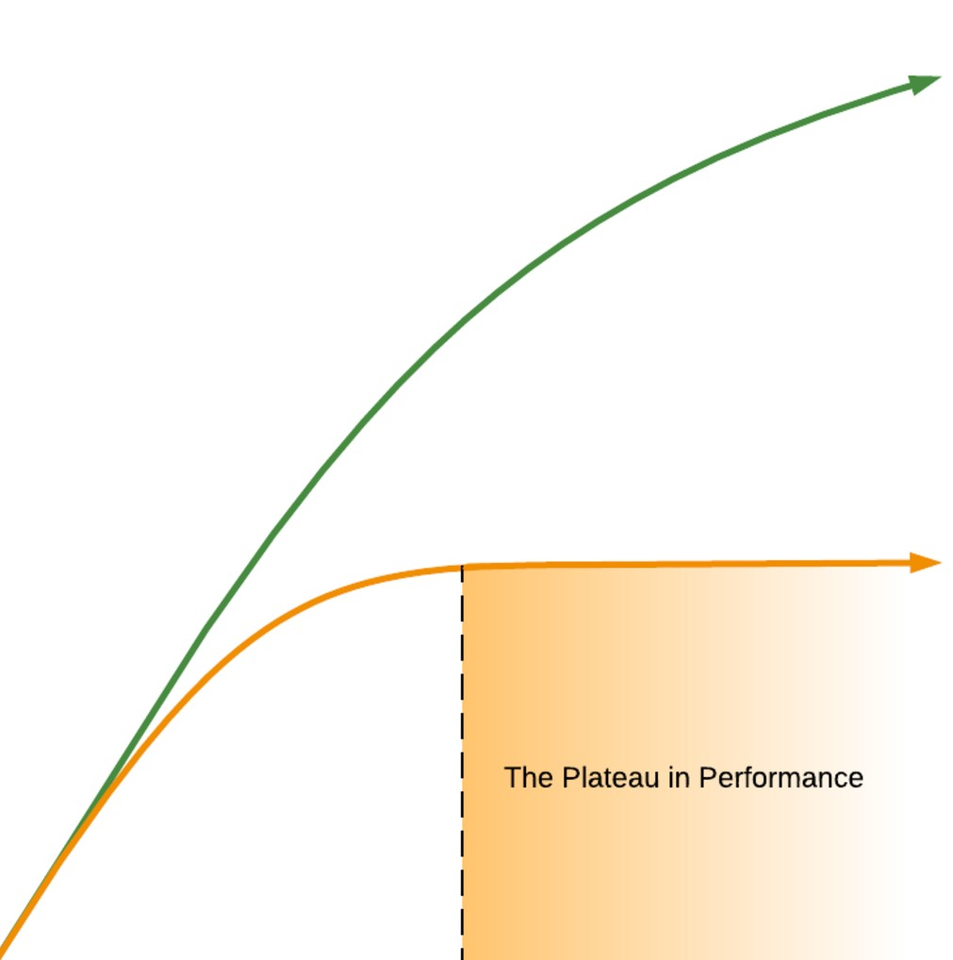
Performance
Deep Learning Algorithms
Performance
Traditional Machine Learning Algorithms
Data

Slide 24
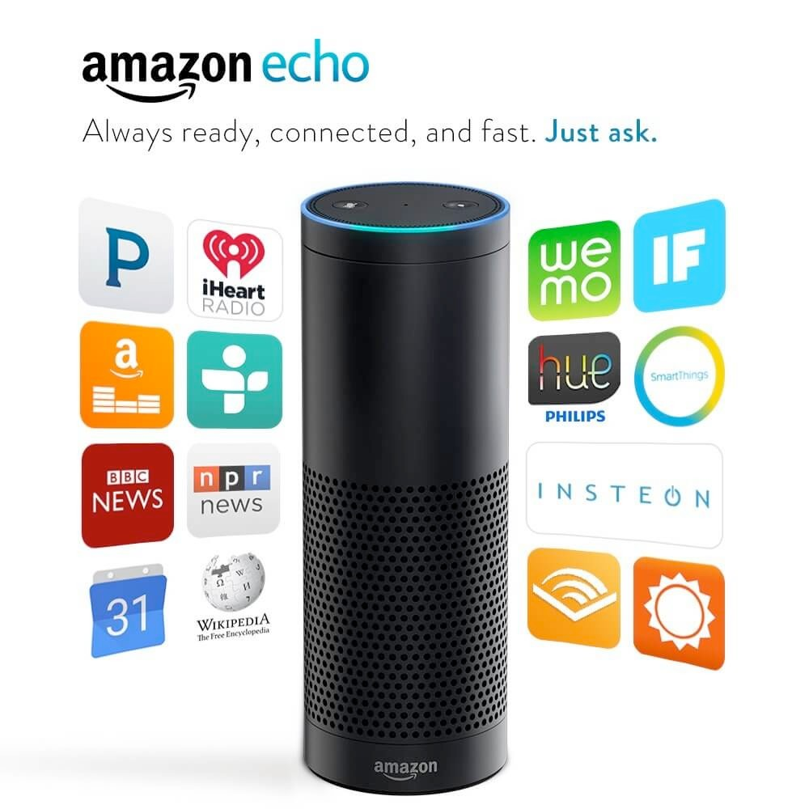
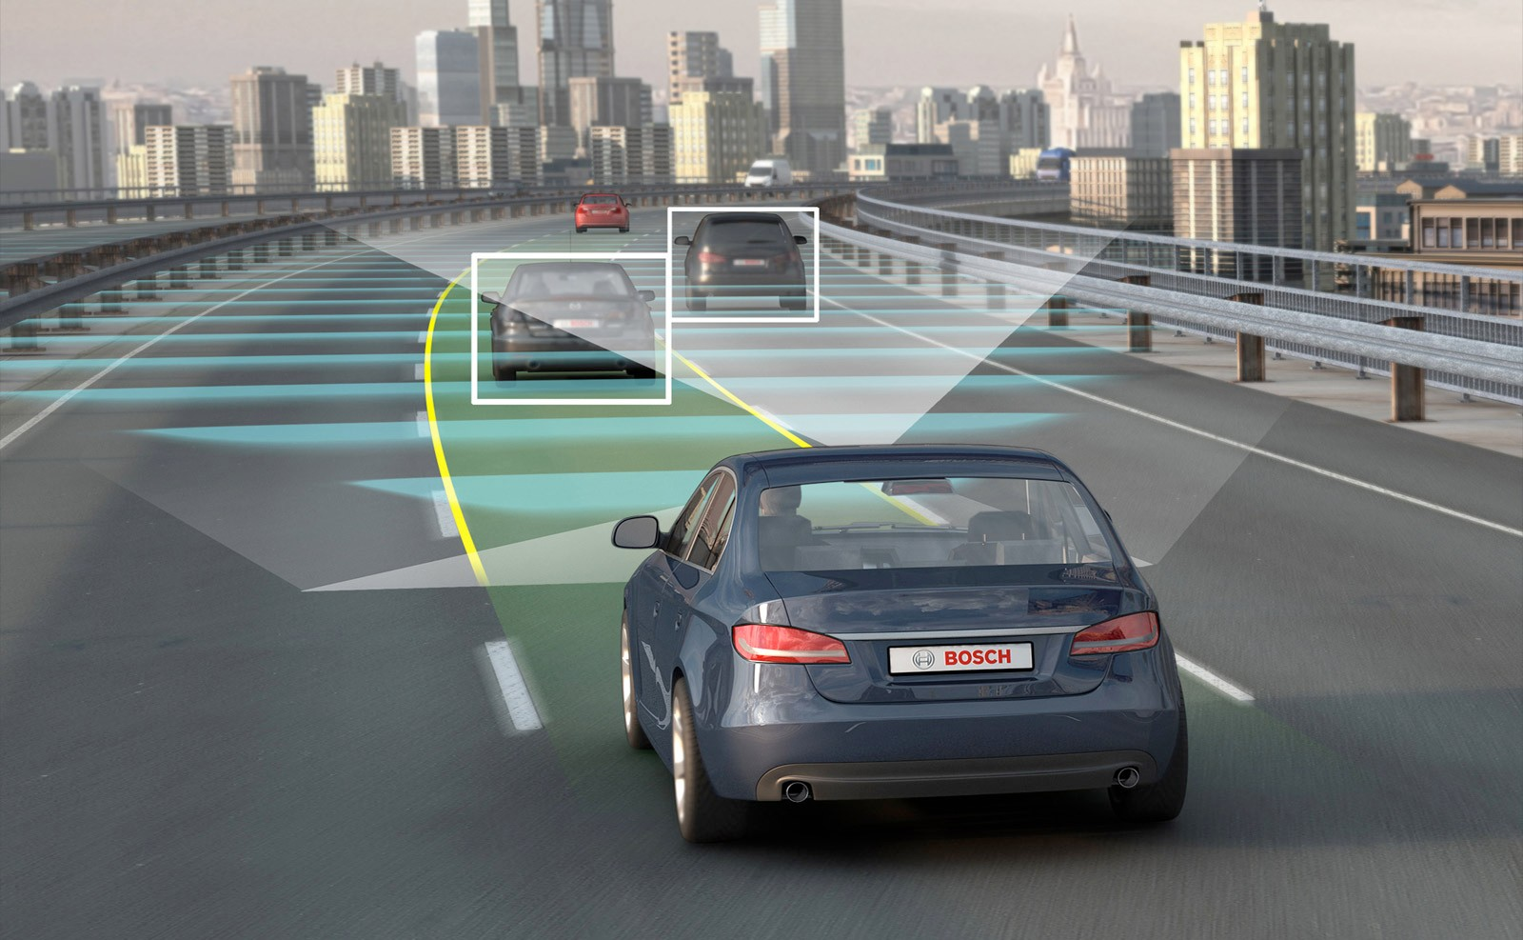
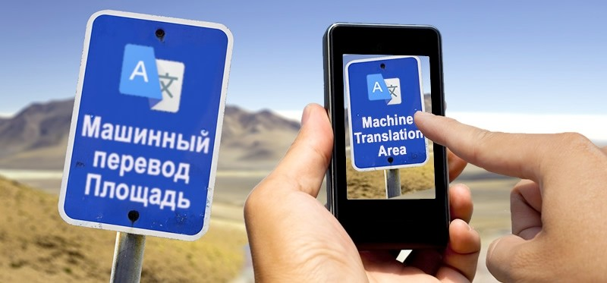
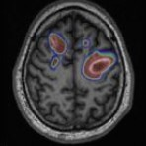
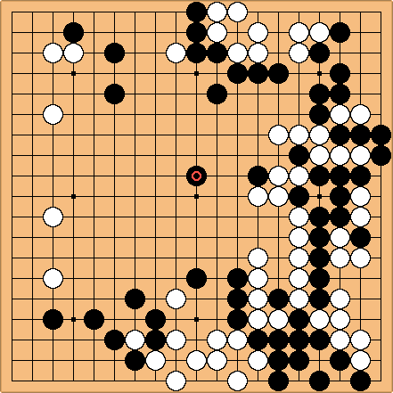
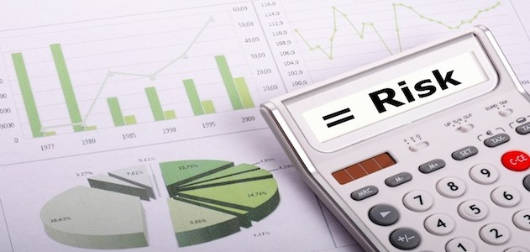
Sample Deep Learning Use Cases
ASR/NLU
Language Translation
Self Driving Cars
Playing Go
Financial Risk
Medical Diagnosis
© 201A
mazon Web Services, Inc. or its Affi

Slide 25
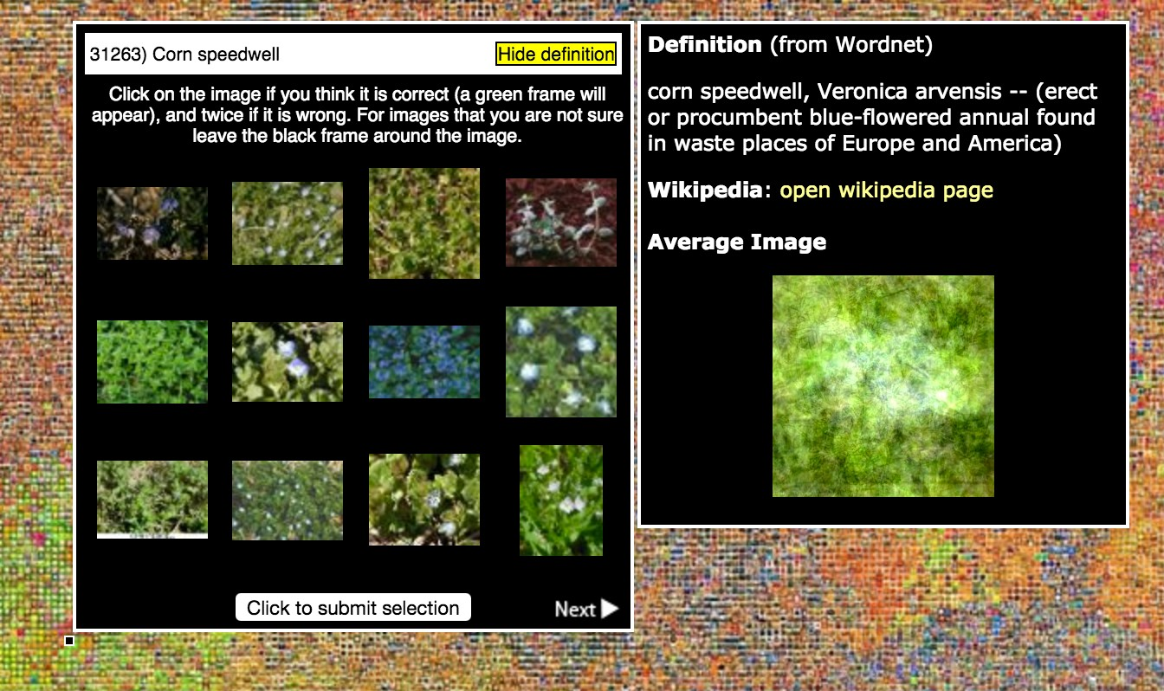
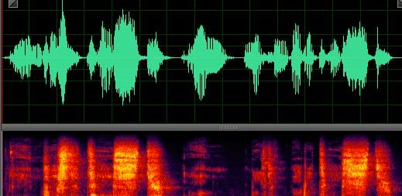

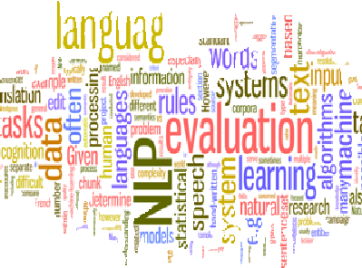
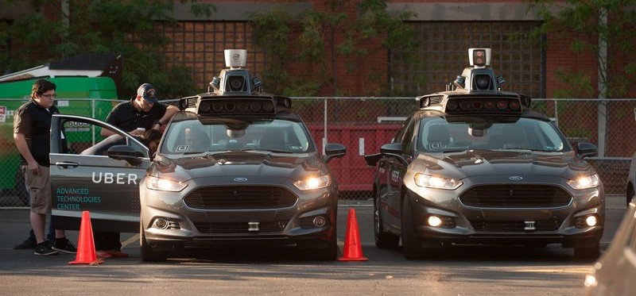
The Advent of Deep Learning
image understanding
Algorithms
speech recognition
Programming Models
Data
natural language processing
GPUs & Acceleration
autonomy

Slide 26
Artificial Neuron/Perceptron
b
Input:
Vector of training data x
Output:
Linear function of input
Nonlinearity:
Transform output into desired range of value
Training
Learn the weights and bias b by minimize loss
X0
w₀
w₁
w₂
X1
Inputs
Neuron
Output
⟨w, x⟩
𝜎
X2
…
w_{n}
Xn
f(x) = 𝜎 (⟨w, x⟩ + b)

Slide 27
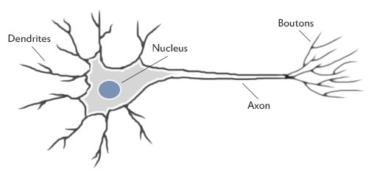
Human Brain Neuron
Output
Inputs

Slide 28
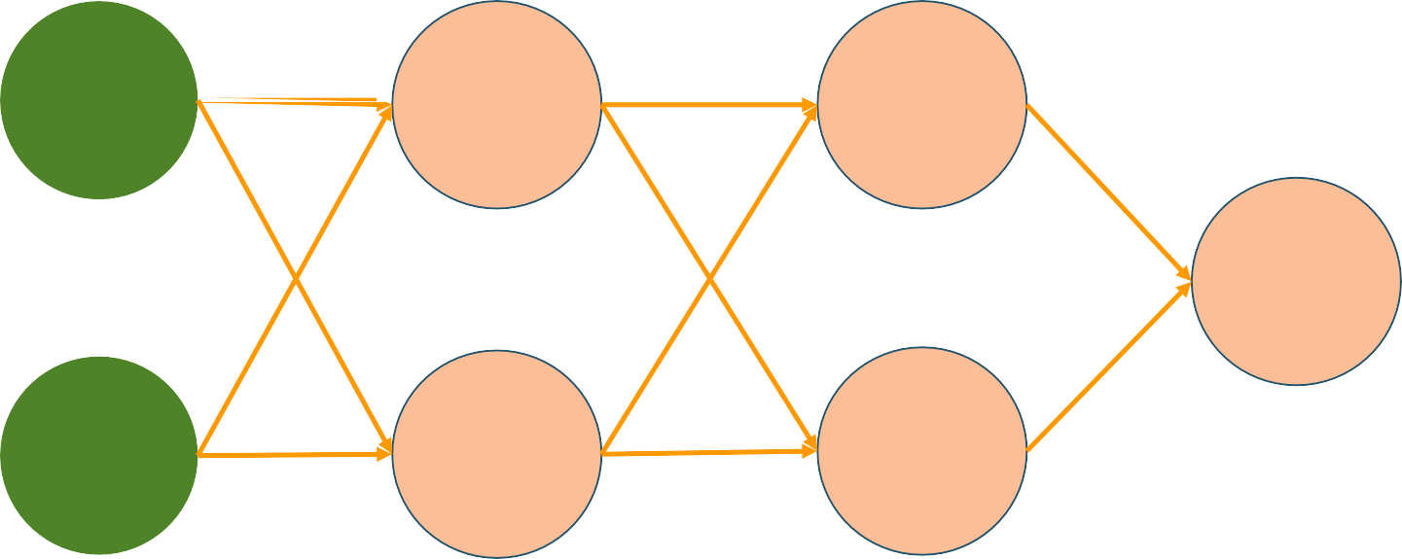
Neural Network
_{w}1
0
X0
Neuron 0
Neuron 0
_{w}1
1
……
……
……
Output Neuron
_{w}1
2
_{w}1
3
Xn
Neuron n
Neuron n
Input Layer
Hidden Layer 1
Hidden Layer 2
Output Layer

Slide 29
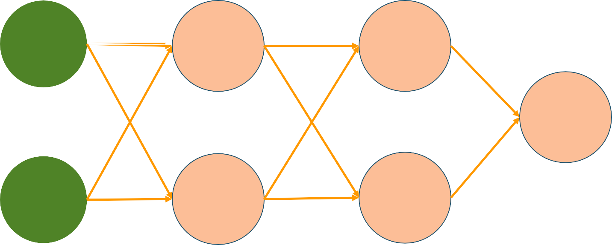

Neural Network – Forward Propagation
_{w}1
0
X0
Neuron 0
Neuron 0
_{w}1
1
……
……
……
Output Neuron
5
Input
_{w}1
2
_{w}1
3
Xn
Neuron n
Neuron n
Input Layer
Hidden Layer 1
Hidden Layer 2
Output Layer

Slide 30
Neural Network – Backpropagation
_{w}1
X0
0
Neuron 0
Error/Loss
Neuron 0
Error/Loss
_{w}1
1
5
……
……
……
Output Neuron
Input
?
_{w}1
2
Label 4
_{w}1
Neuron n
Error/Loss
Neuron n
Error/Loss
Xn
3
Error/Loss
Input Layer
Hidden Layer 1
Hidden Layer 2
Output Layer

Slide 31

Neural Network – Backpropagation
Update weights
_{W}1’_{0 W}1’₁
_{W}1’_{2 W}1’₃
X0
Neuron 0
Error/Loss
Neuron 0
Error/Loss
……
……
……
5
Output Neuron
Input
?
Label 4
Xn
Neuron n
Error/Loss
Neuron n
Error/Loss
Error/Loss
Output Layer
Input Layer Hidden Layer 1
Hidden Layer 2

Slide 32
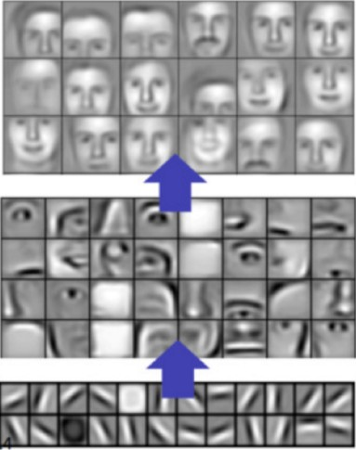
Computer Vision – Deep Learning Approach
Classification
Object Prediction
Object Model Detection
Feature Extraction
Object Parts Detection (Combination of edges)
Edge Detection
Raw Image Pixels

Slide 33




Language Translation – Deep Learning Approach
Input One Word At a
Time
Output One Word At a
Time
Model
Encoded Vector
Model
“How”
“Are”
“You”
0.643
0.875
0.345
.
.
你 好 吗
Encoder
Decoder
Memory of previous word influences next result
Memory of previous word influences next result

Slide 34
Thank You

